Slide 1
Test Automation Framework

Slide 2
Automation Stack
Jira – Software development tool
Test Rail - Test case management
Github - Code repository
Selenium - Automates browsers. Implemented Page Object model that maps pages to the UI to reduce duplicity, improve readability, and ease maintainability
Java - Programming language
TestNG - Test framework for parallel test execution with flexible configurations
Jenkins - Continuous integration. Stores build history, logs, test results, reports, artifacts. Sends email notifications along with build artifacts.
Maven - Build deployment
Slack - Real-time messaging
Sauce Labs - Cloud service provides parallel test runs with multiple platform/browser/version configurations. Saves steps, screenshots, and screencasts
Jmeter - API and load testing
Log4J - logging

Slide 3
Benefits
Maximize efficiency
Increase productivity
Reduce costs

Slide 4
How?

Slide 5
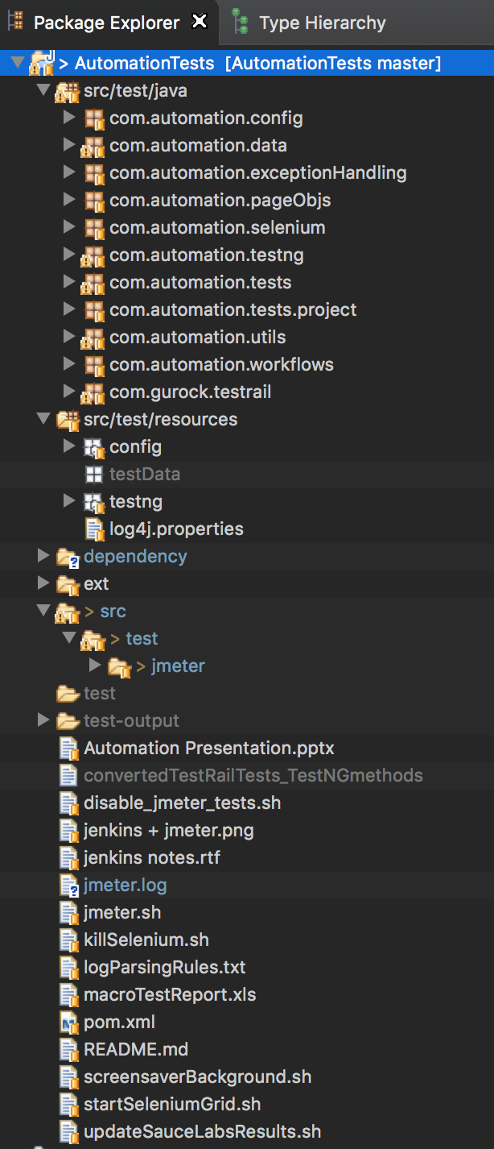
Java Project dir structure

Slide 6
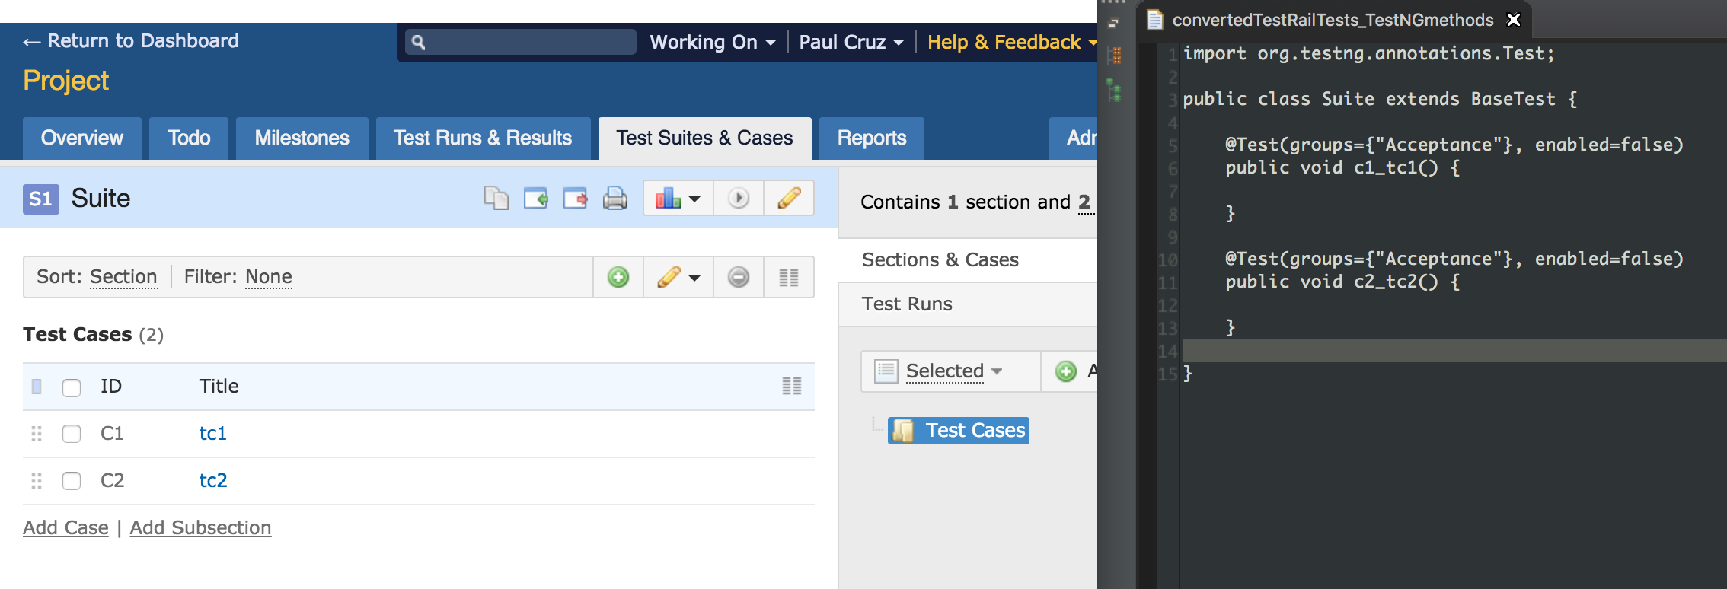
Convert Test Rail test cases to TestNG methods
Script requires 2 parameters:
Test Rail project id
Test Rail suite id
Test Rail conversion:
Test case type = TestNG group
Test case id and name = TestNG method name

Slide 7
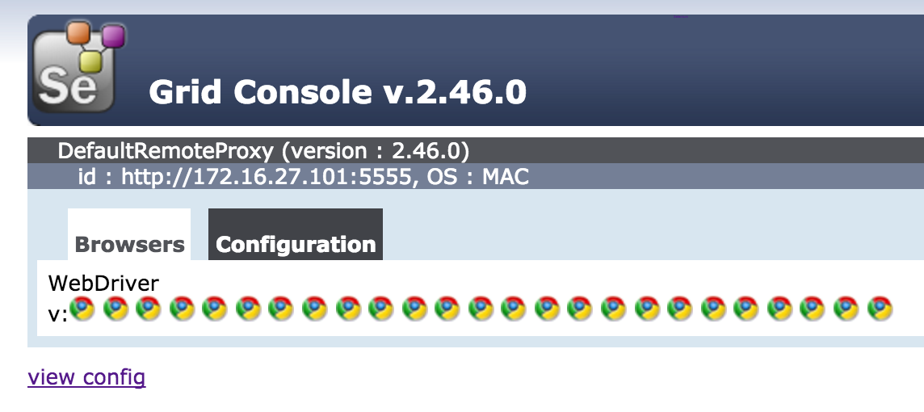
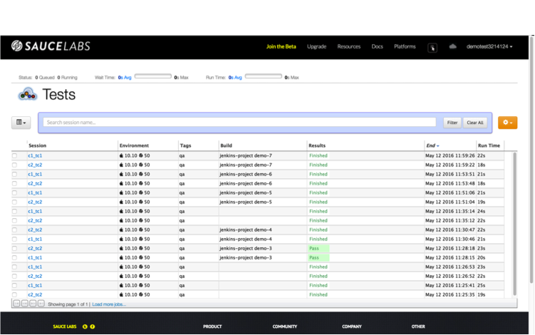
Run where?
Run tests locally on the Selenium Grid when writing/debugging tests
Run tests in the cloud on Sauce Labs when a build is deployed

Slide 8
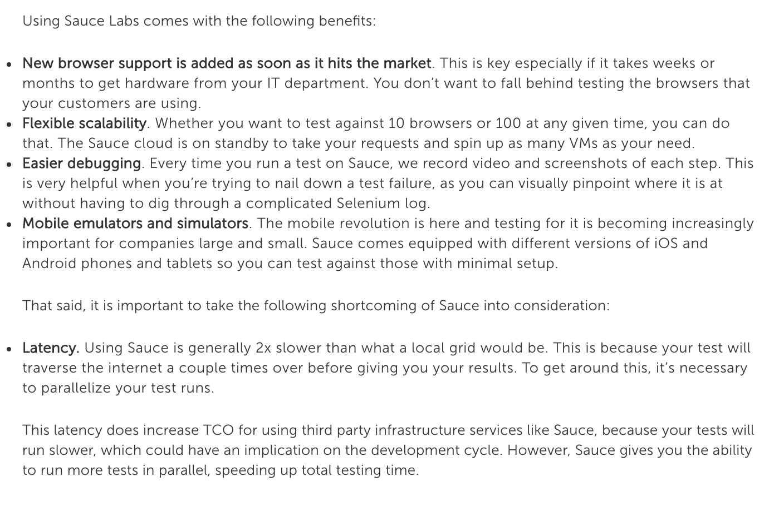
Sauce Labs

Slide 9
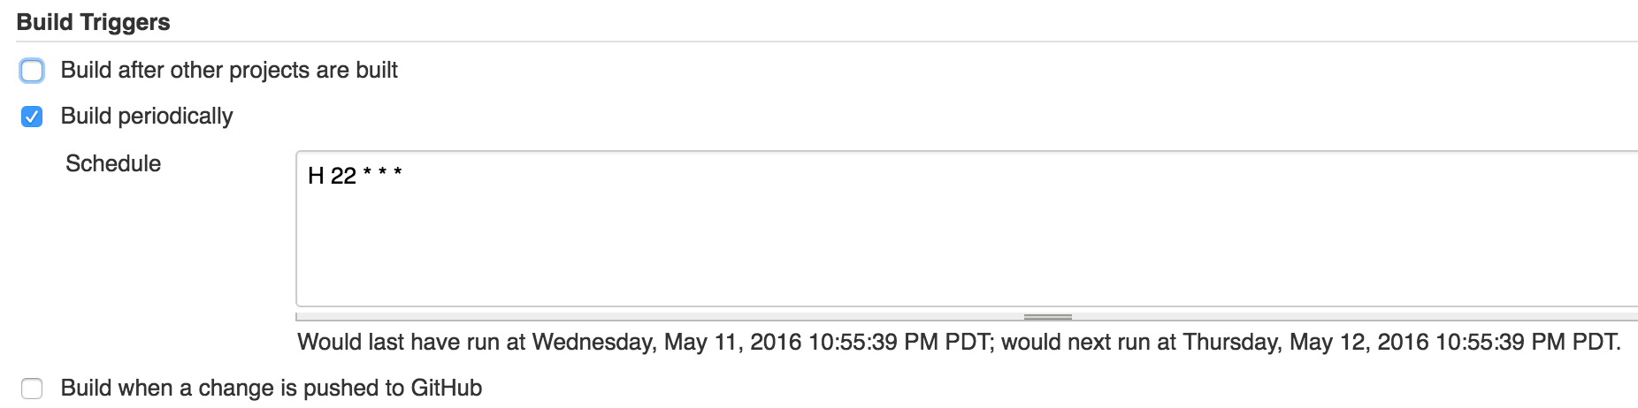
Configure Jenkins Build Triggers

Slide 10
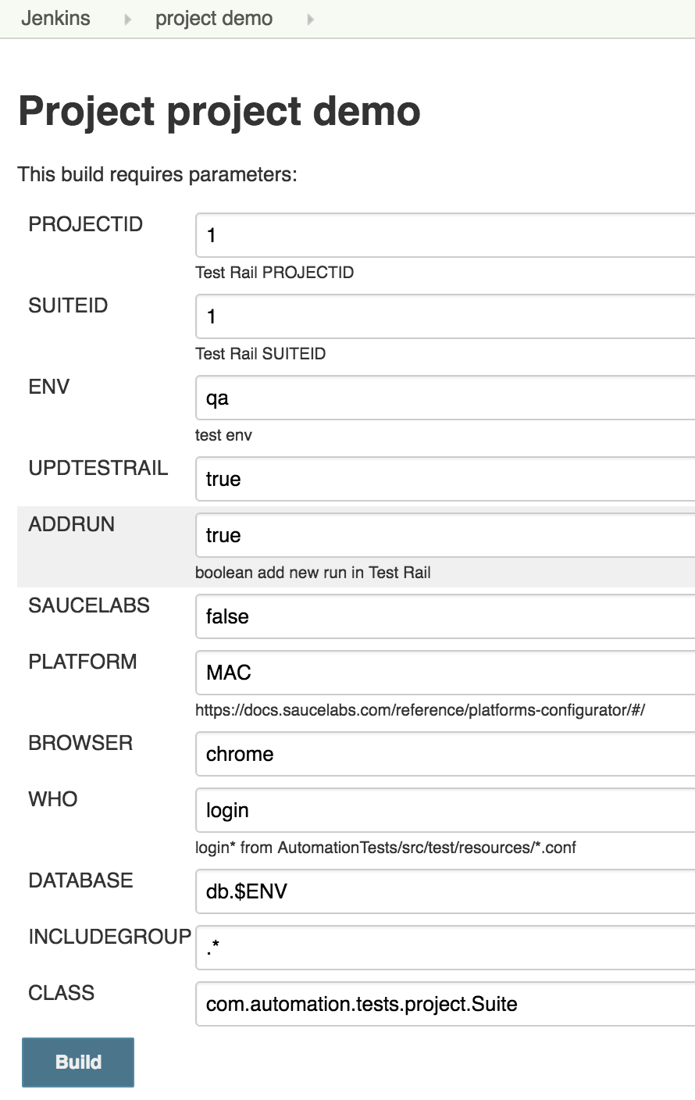
Jenkins parameterized build

Slide 11
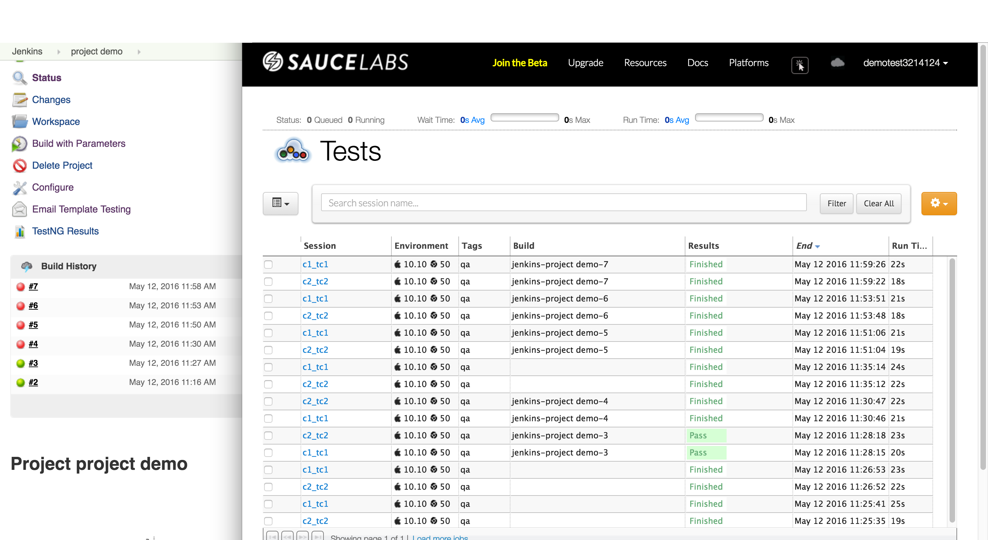
Jenkins + Sauce Labs
Notes:
adsfasd

Slide 12
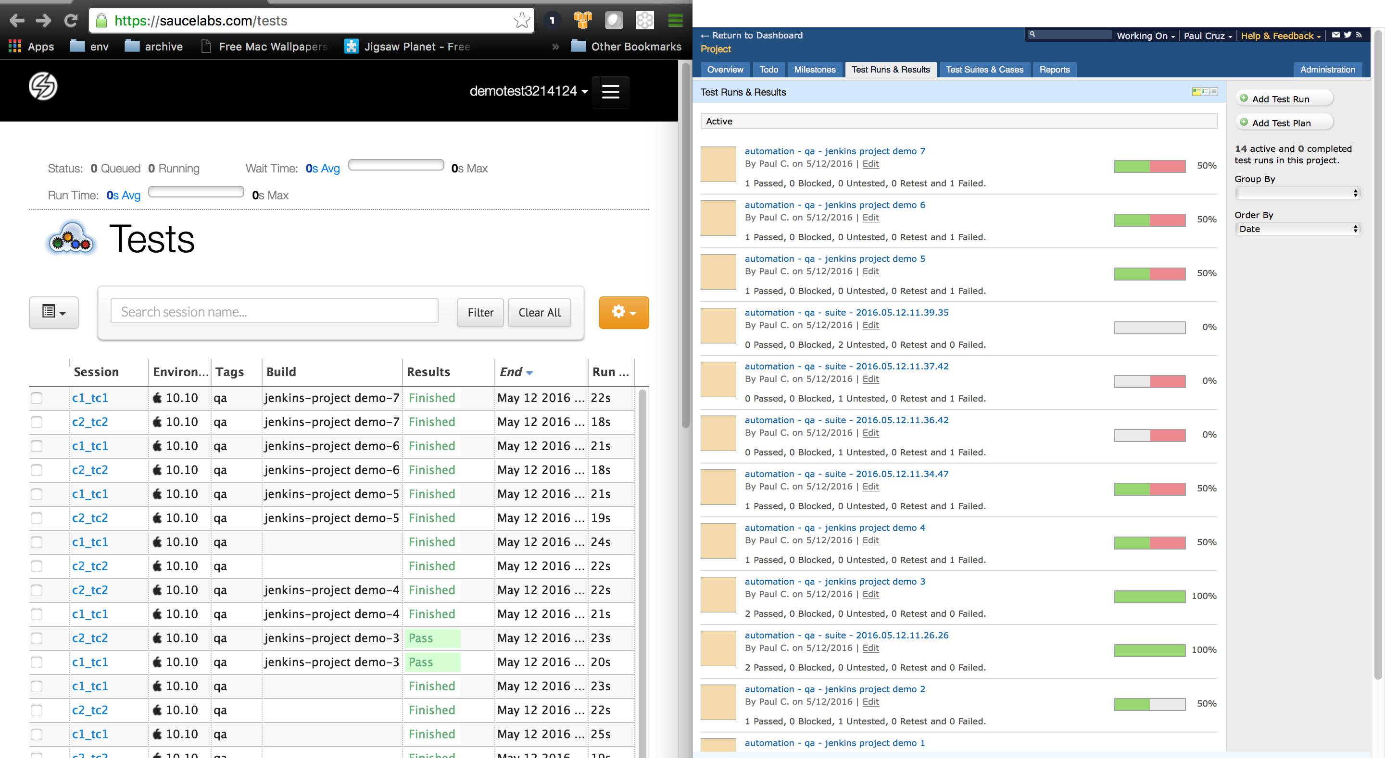
Sauce Labs + Test Rail

Slide 13
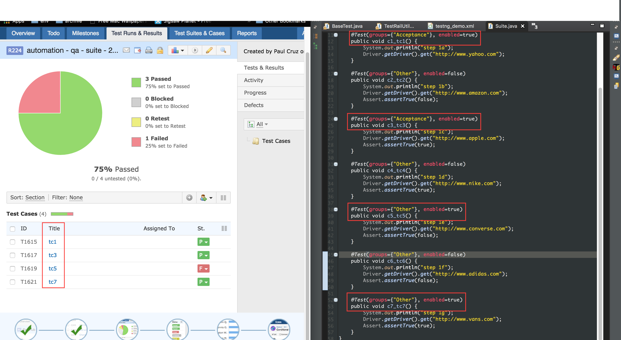
Test Run only contains enabled tests

Slide 14
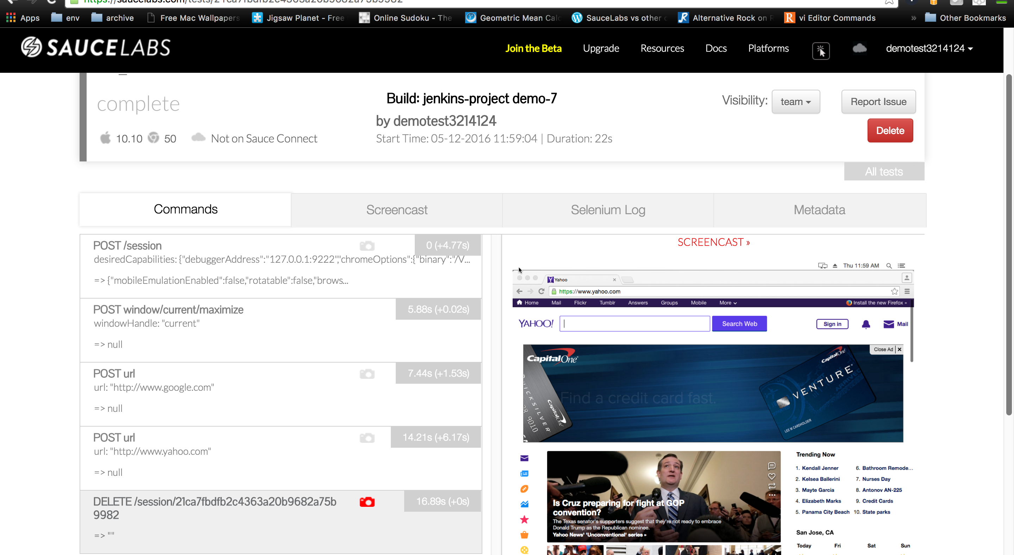
Screenshots

Slide 15
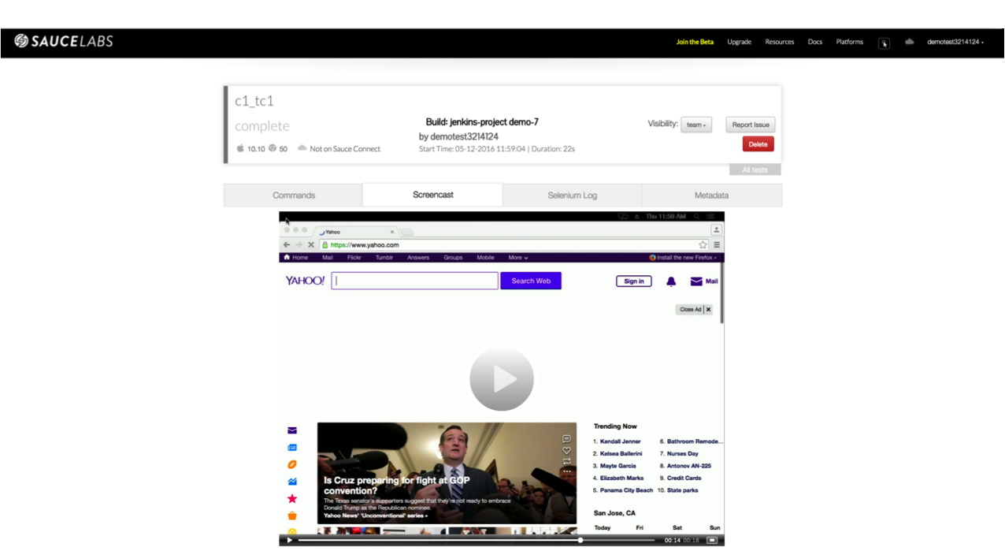
Screencast

Slide 16
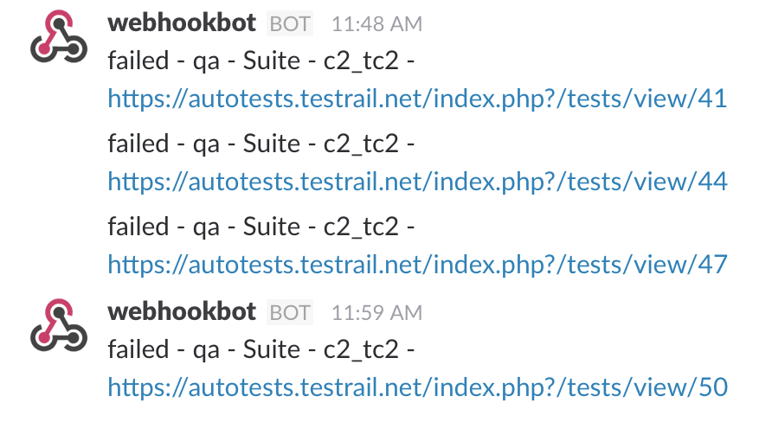
Real-time messaging
As the build is running, if tests fail, integrated Slack to provide real-time messaging to notify our automation channel with the following:
- Env where test failed
- Test Suite name
- Test case name
- Link to Test Rail result which will provide more details

Slide 17
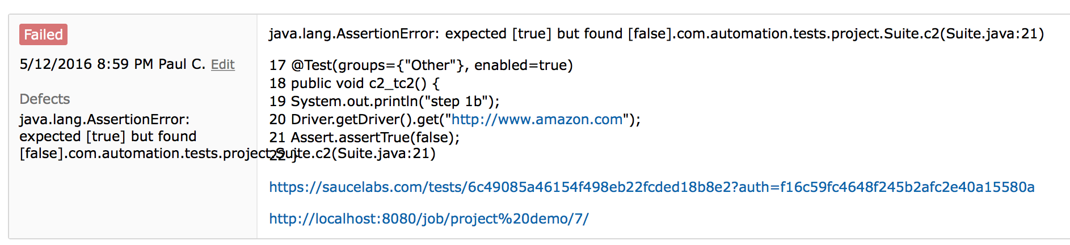
Update Test Rail
Mark test case as automated
Exceptions
Automated steps prefixed with the line #
Link to the Sauce Labs session
Link to the Jenkins build

Slide 18
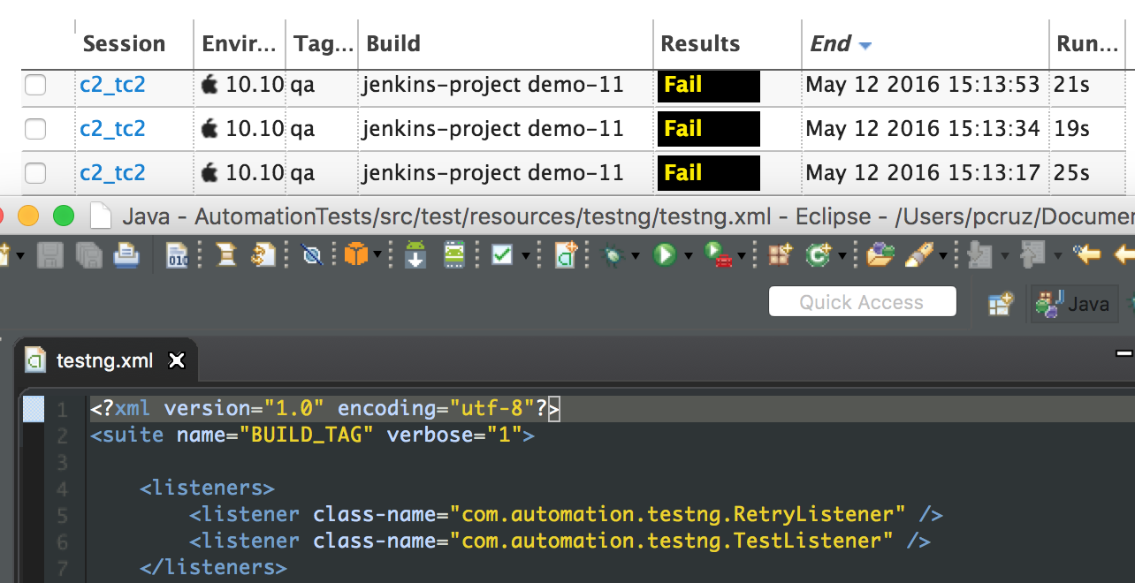
Retry failed tests

Slide 19
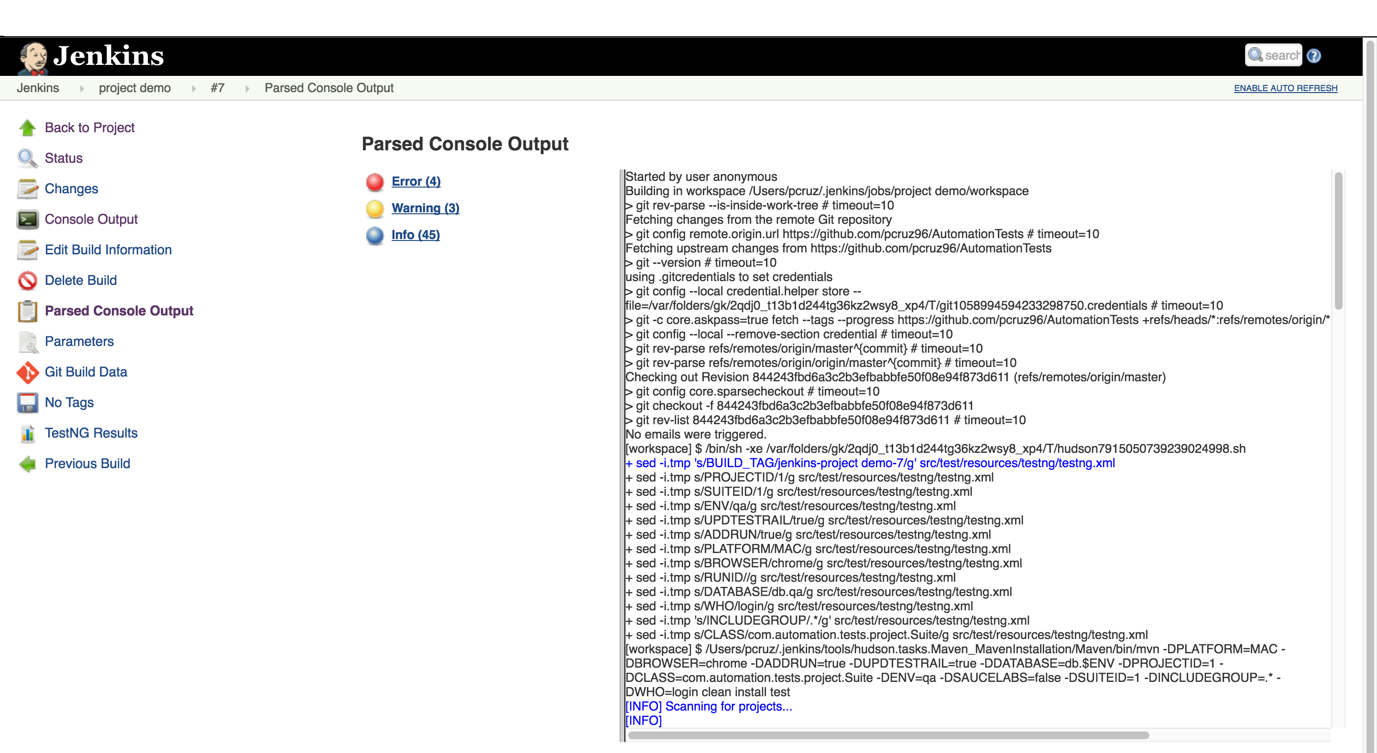
Parsed Console Output for Jenkins build

Slide 20
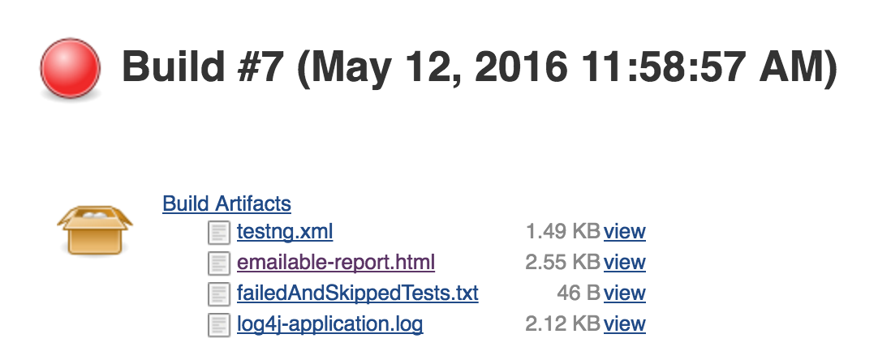
Email Build Artifacts post-build

Slide 21
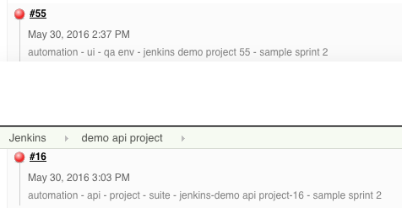
Jenkins Build description

Slide 22
Naming convention
For traceability:
TestNG method name will include the Test Rail case id and name
Test Rail run name will be “automation - env - Jenkins build tag or timestamp if ran locally”
Sauce Labs:
Sessions = TestNG method
Tags = test env
Build = Jenkins build tag

Slide 23
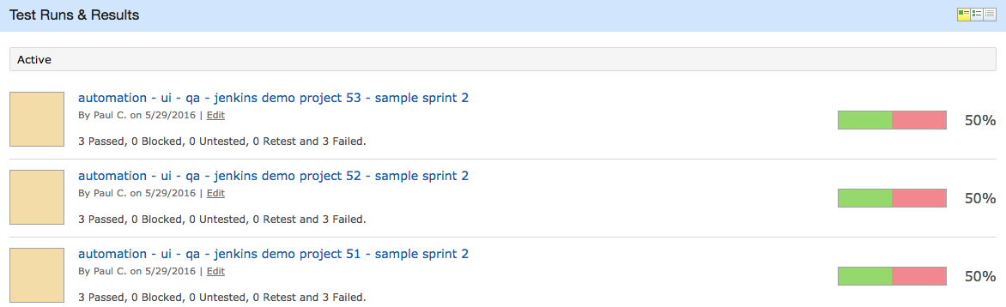
Naming convention

Slide 24
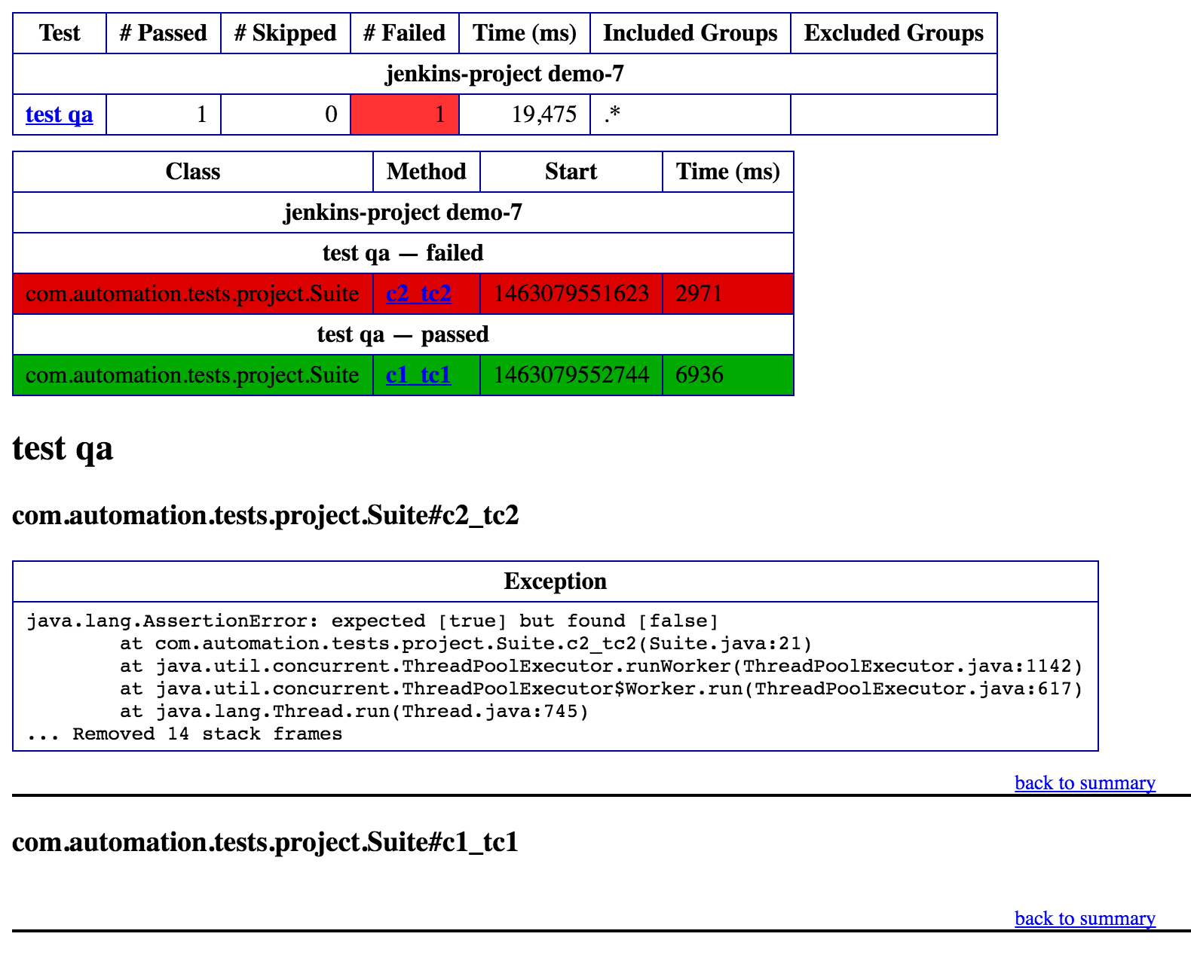
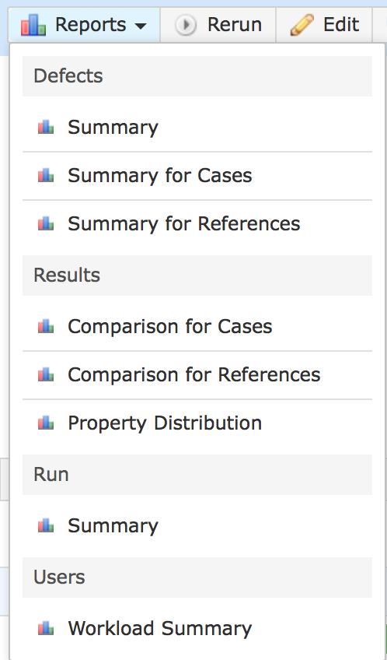
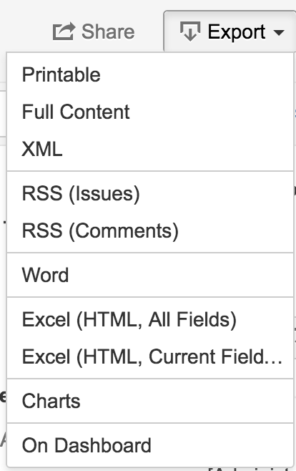
Built-in Reports
TestNG emailable-report.html TestRail
Jira

Slide 25
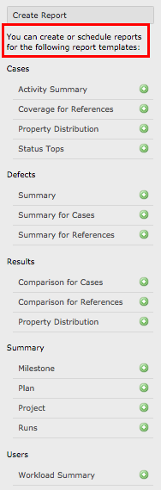
Schedule various report templates

Slide 26
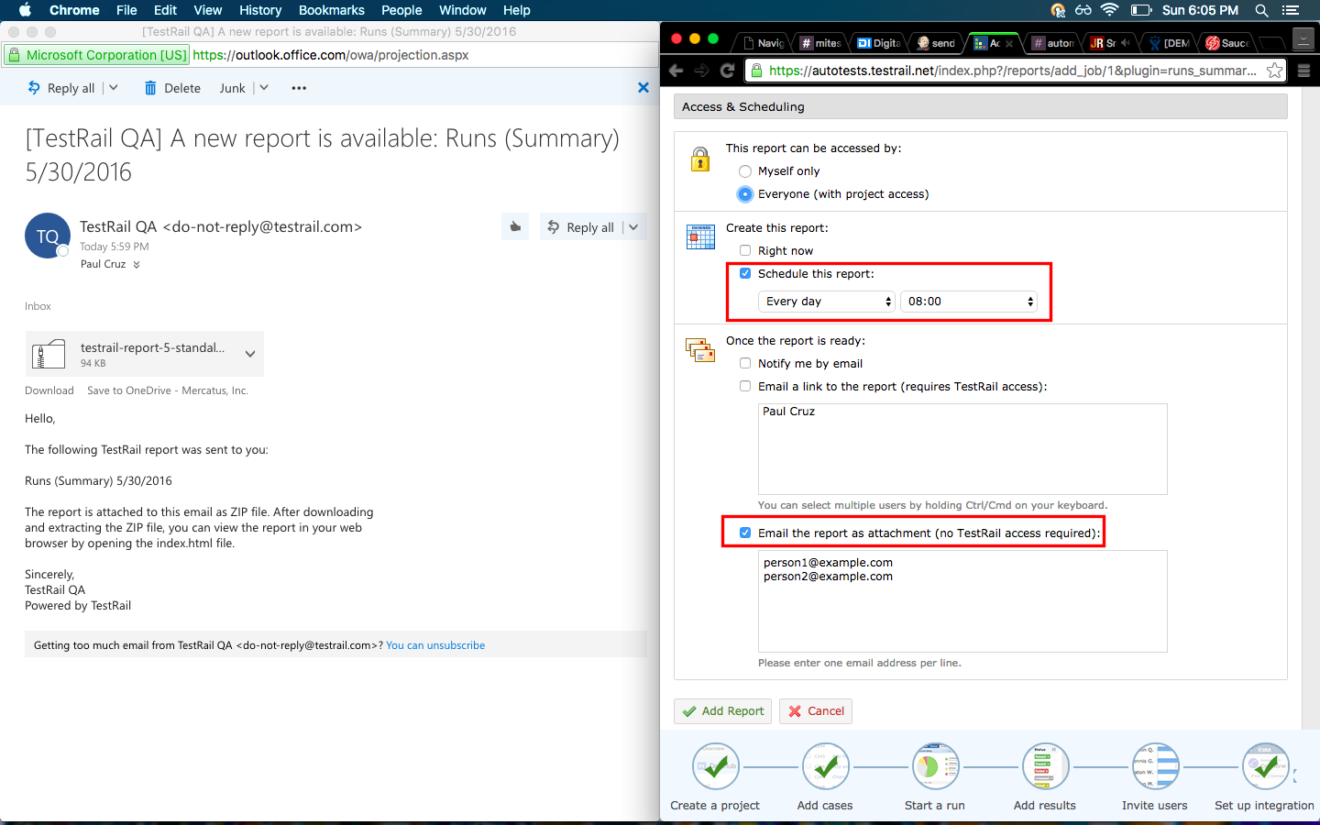
TestRail reports

Slide 27
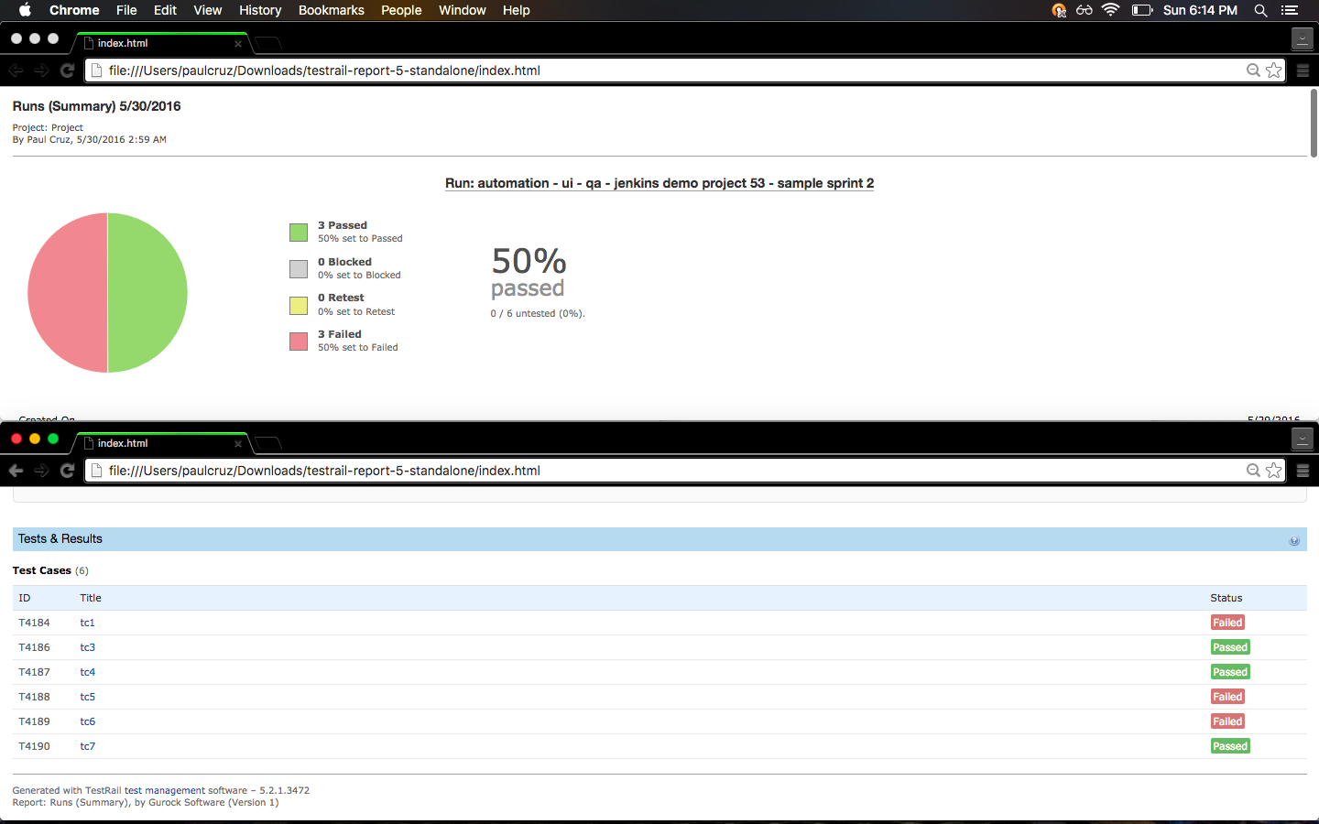
Sample report

Slide 28
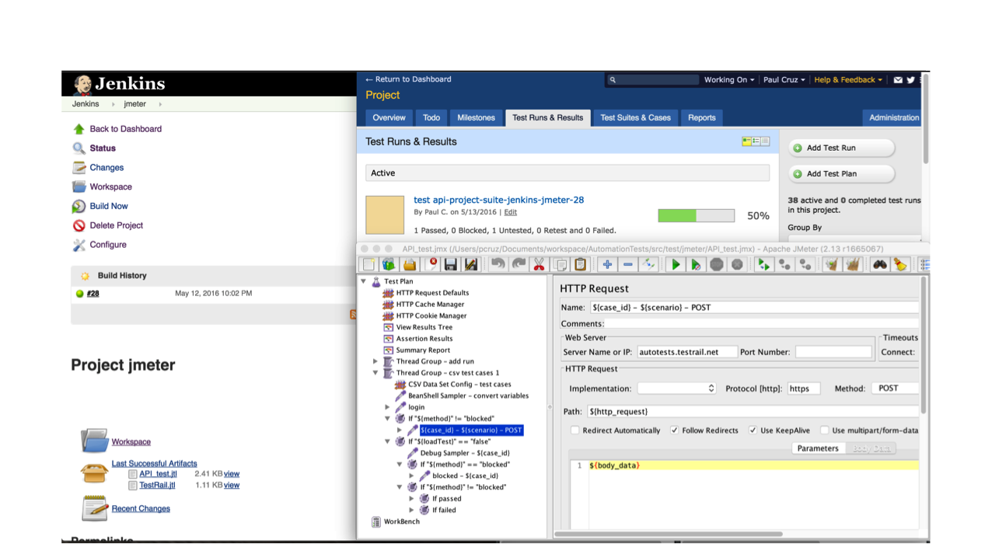
JMeter – API & Load tests

Slide 29
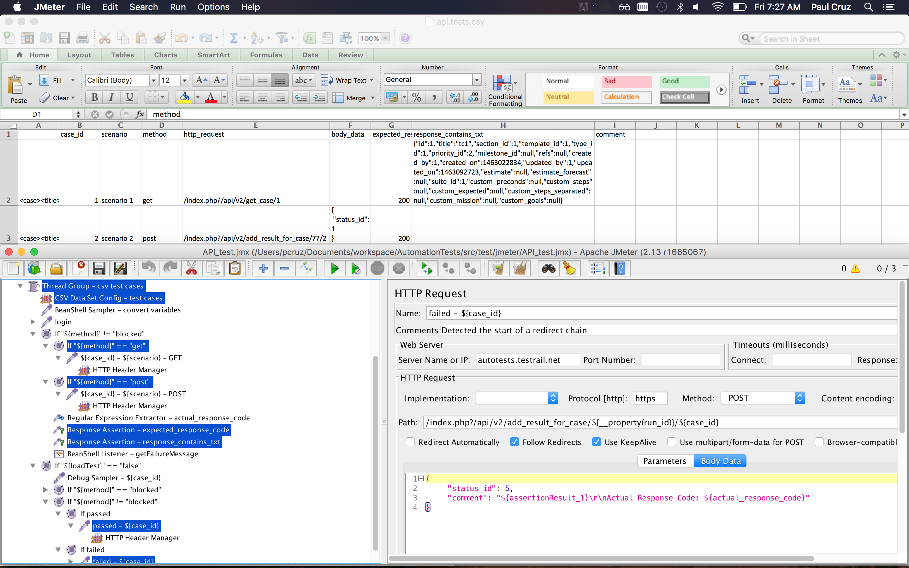
JMeter API + CSV

Slide 30
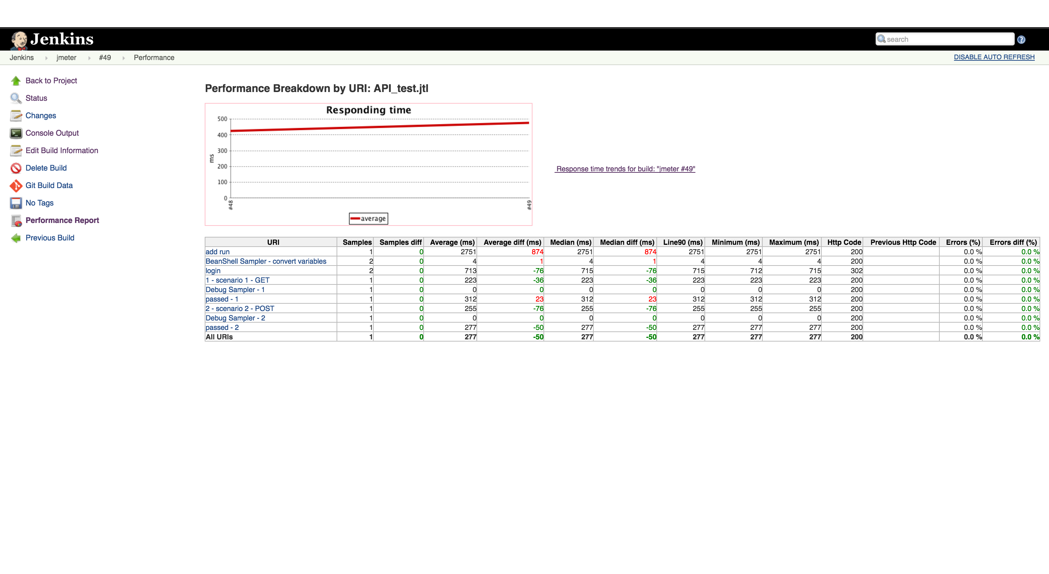
Jenkins + JMeter

Slide 31
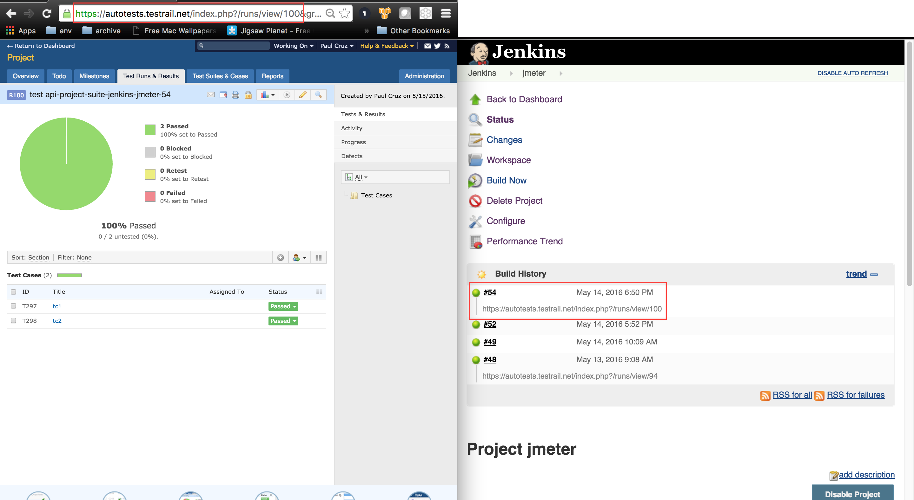
Jenkins + JMeter + TestRail

Slide 32
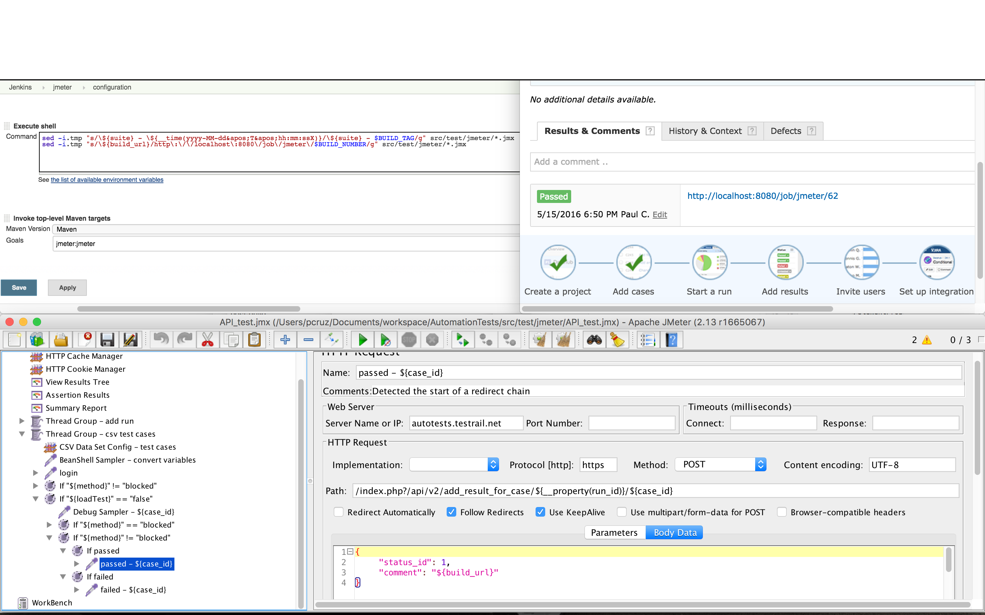
Jenkins traceability

Slide 33
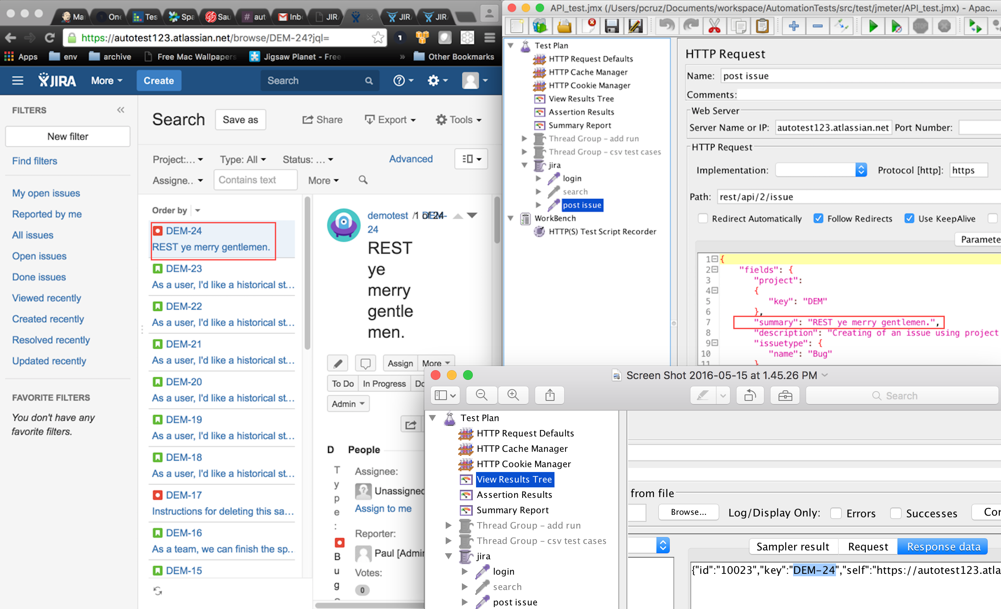
JMeter + Jira

Slide 34
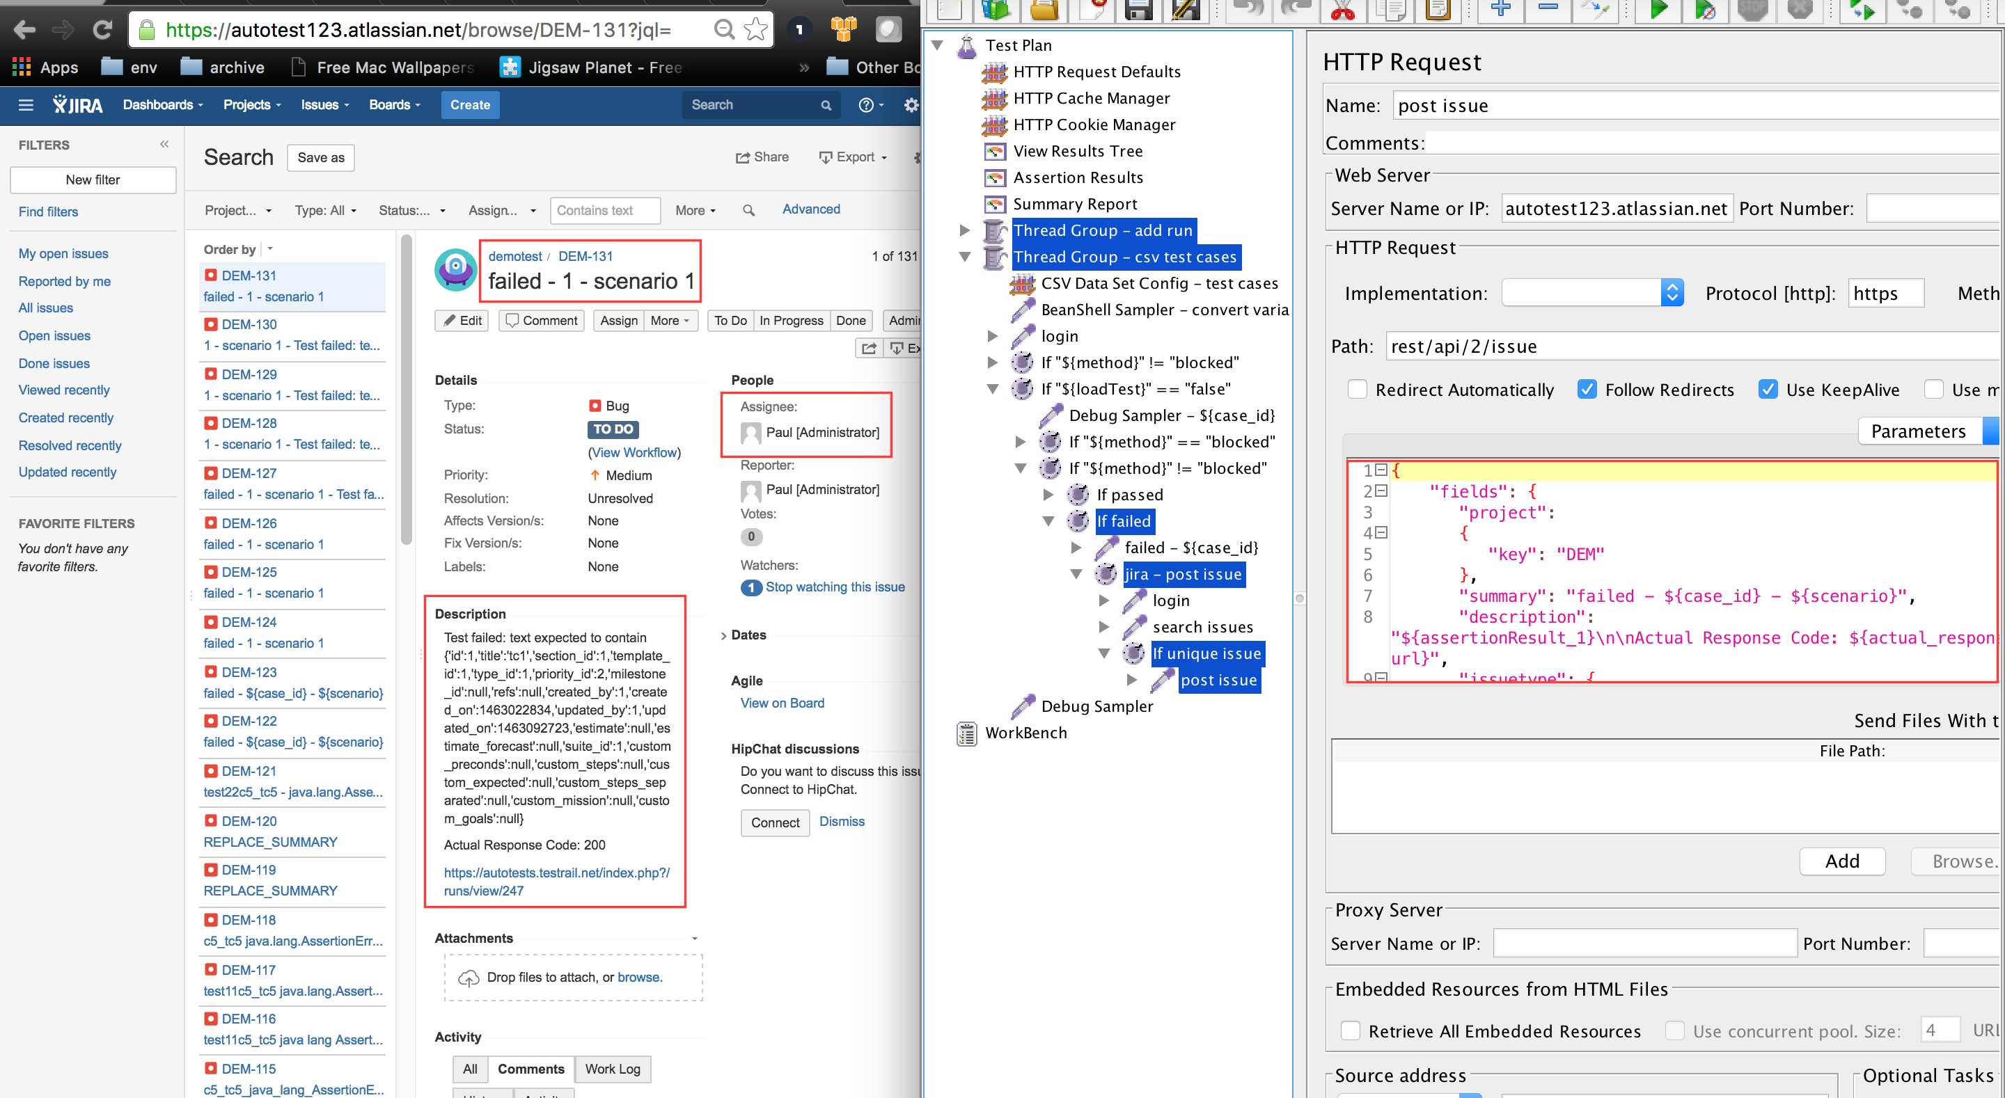
JMeter + Jira + TestRail

Slide 35
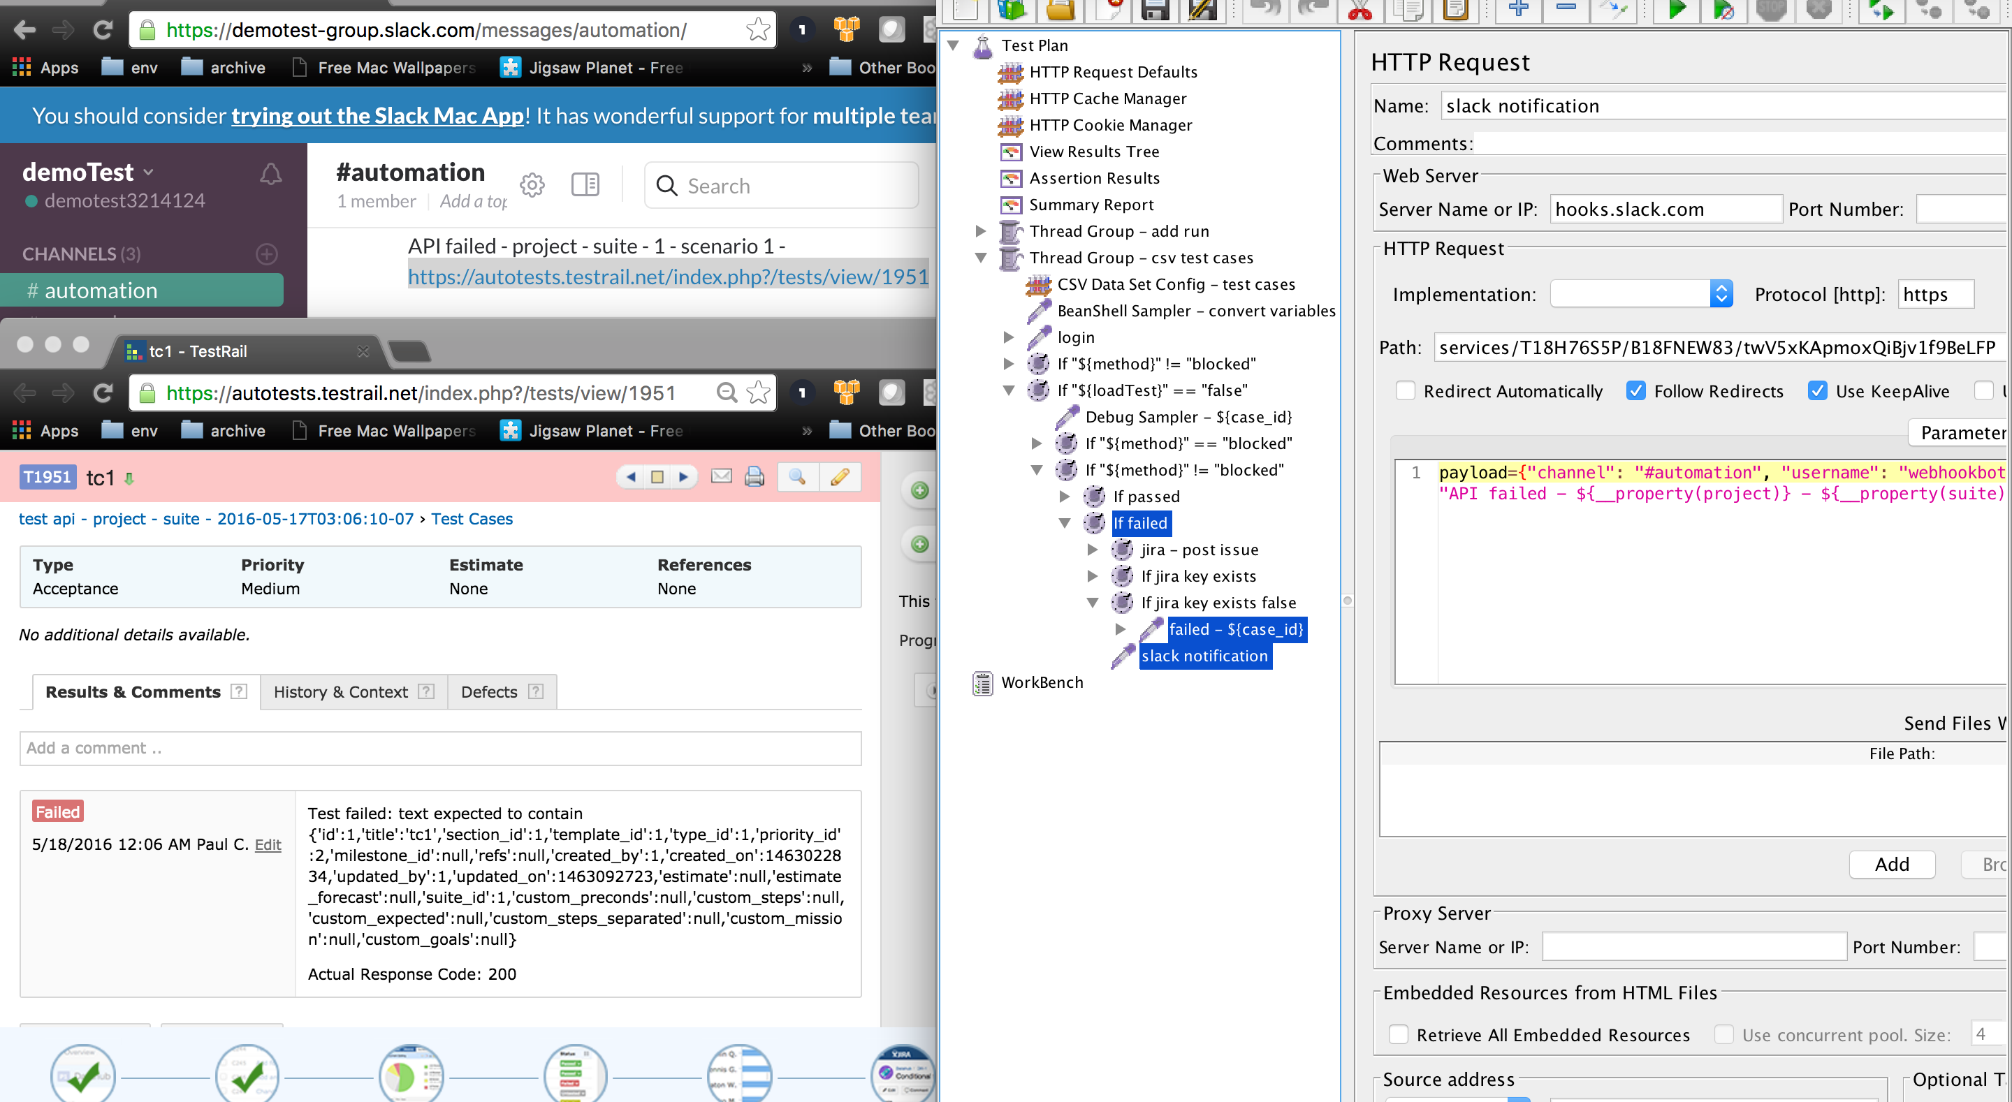
Jmeter + Slack + TestRail

Slide 36
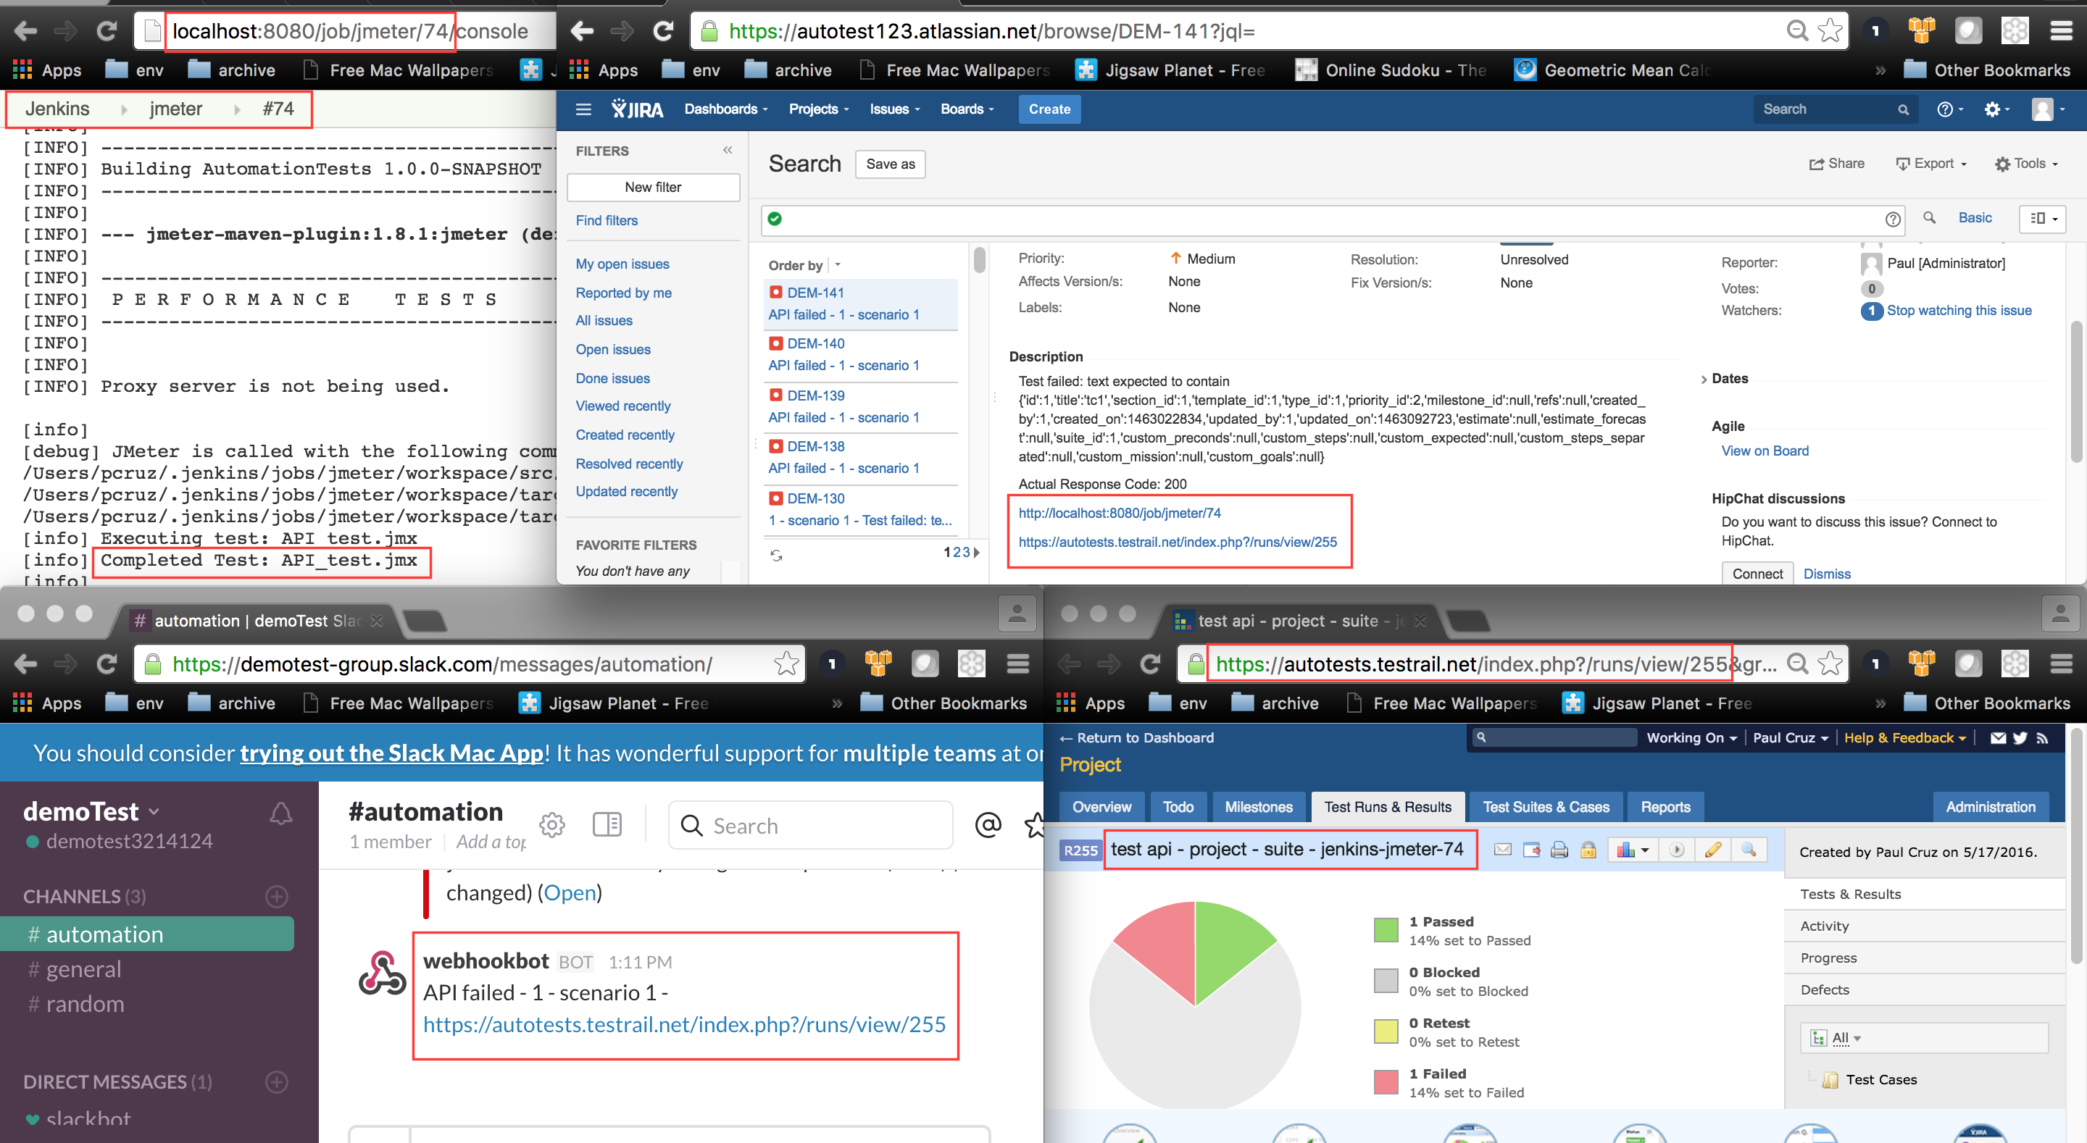
JMeter + Jenkins + Slack + Jira + TestRail

Slide 37
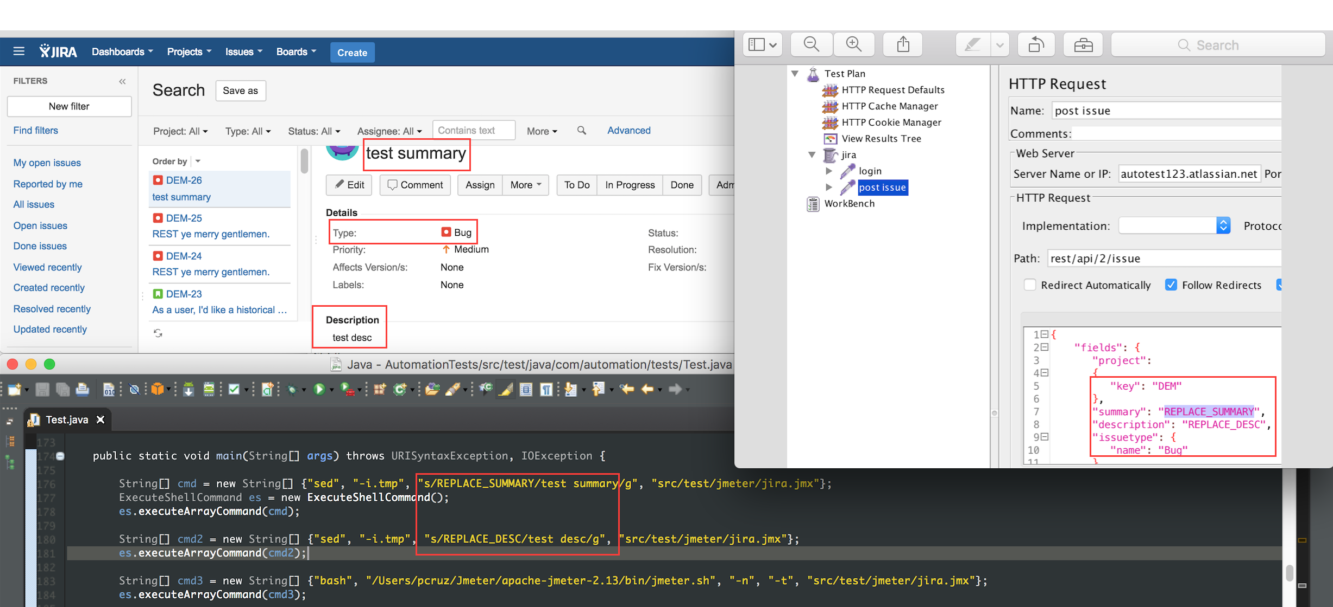
Java + JMeter + Jira

Slide 38
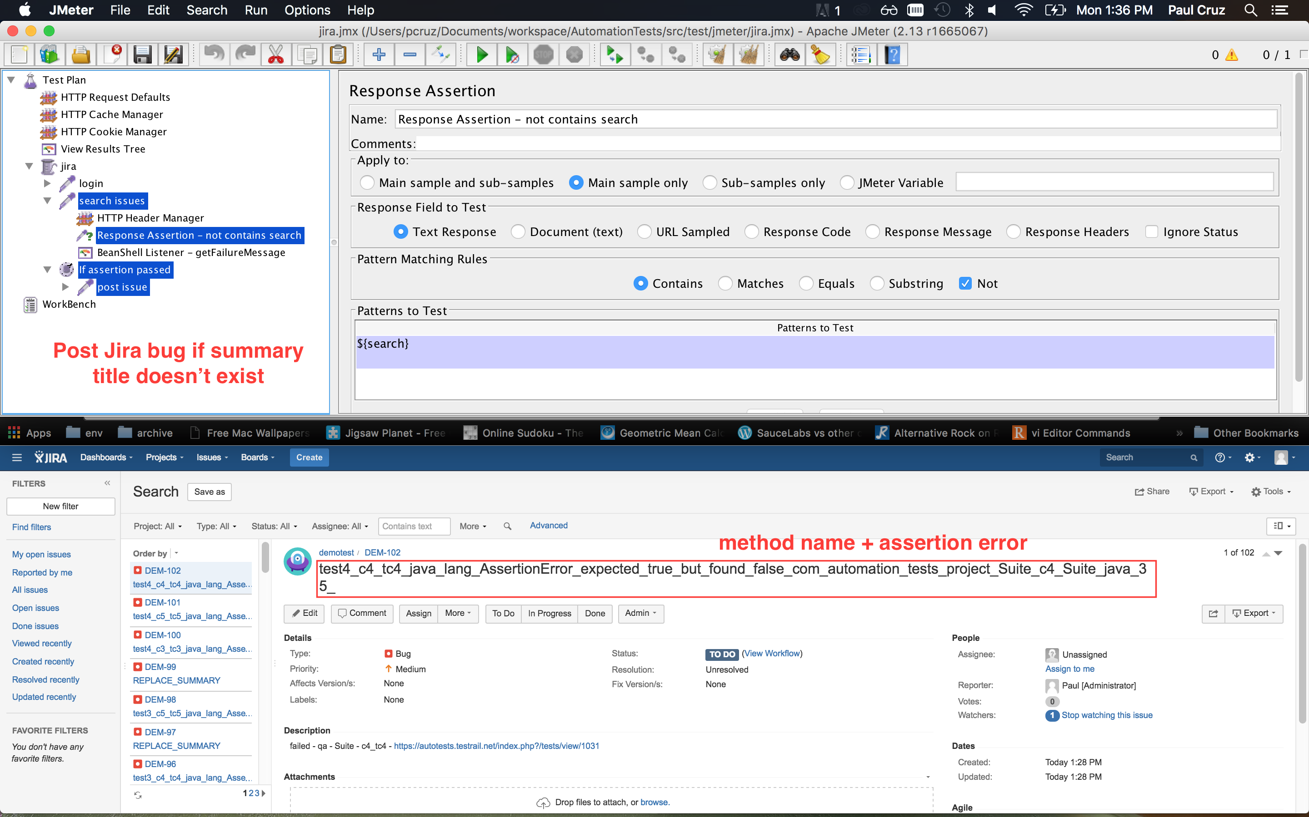
Jira Bugs

Slide 39
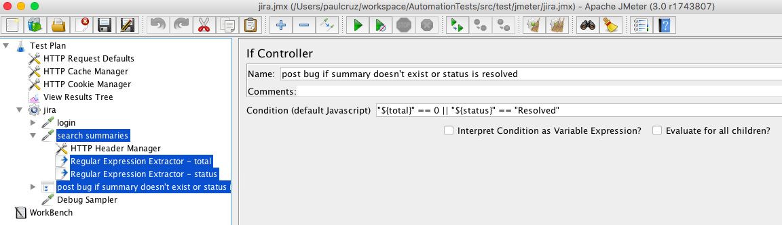
Post Jira bug if summary doesn't exist or status is resolved

Slide 40
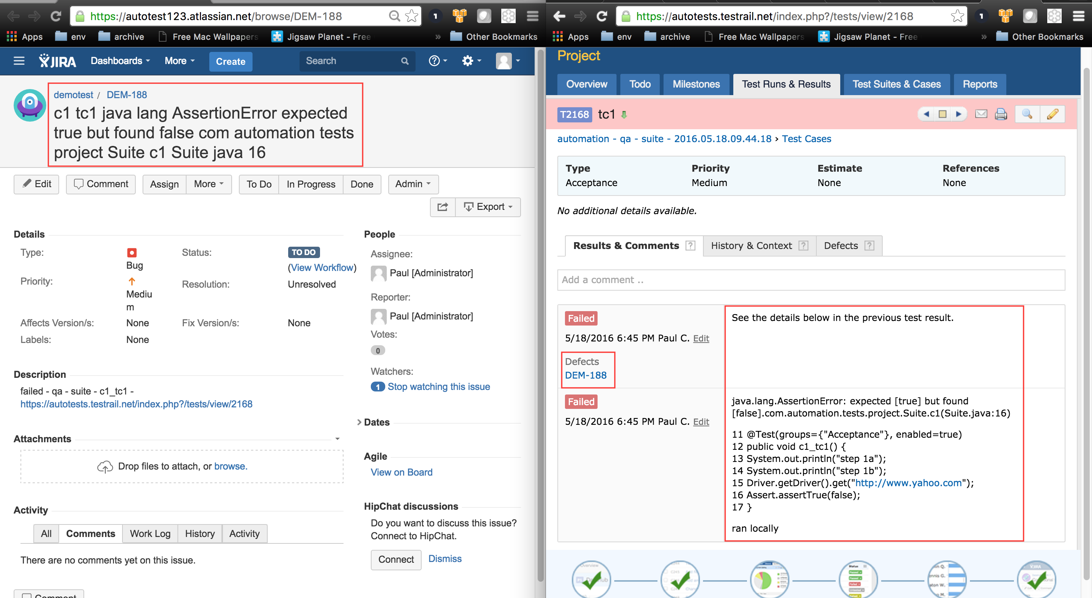
Jira + TestRail

Slide 41
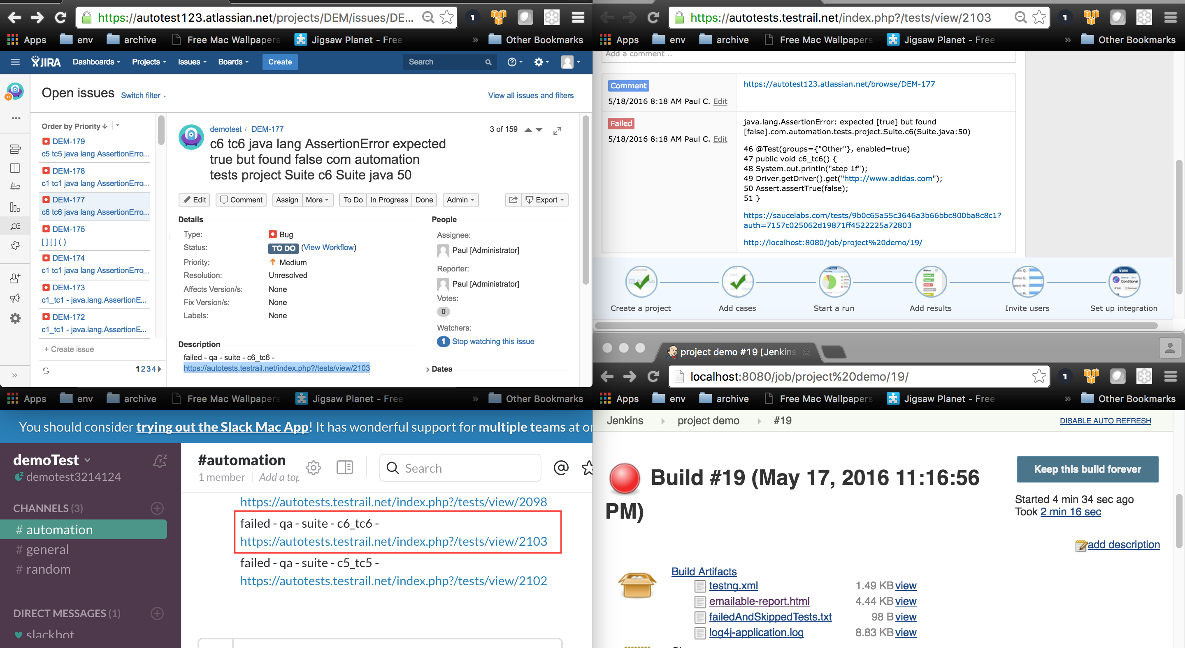
Jenkins + Slack + TestRail + Jira

Slide 42
Q & A Thank you!

